Slide 1


the Triple Aim, Volume to Value, Population Health, AND Washington’s Medicaid Transformation:
WHAT’S it all Mean, and how does it Impact Credentialing?
2017 Education Conference

Slide 2
How did we get here?
Brief history: Volume to value and population health

Slide 3
Unabated Pressure on Hospitals…
There are three main areas of pressure facing acute care hospitals in today’s environment: declining revenue, capital demands, and new payment/business models.
Declining Revenue
Increased Costs/ Capital Demands
New Payment/ Business Models
Decrease in governmental reimbursement.
Commercial payor pressure.
Lower utilization.
IT needs.
Physician strategies.
Technological and physical plant investments.
Business models needed for ACO success.
Capitation and similar payments.
Source: http://www.healthlawyers.org/Events/Programs/Materials/Documents/AM11/fishman_neumann_owens_slides.pdf.

Slide 4
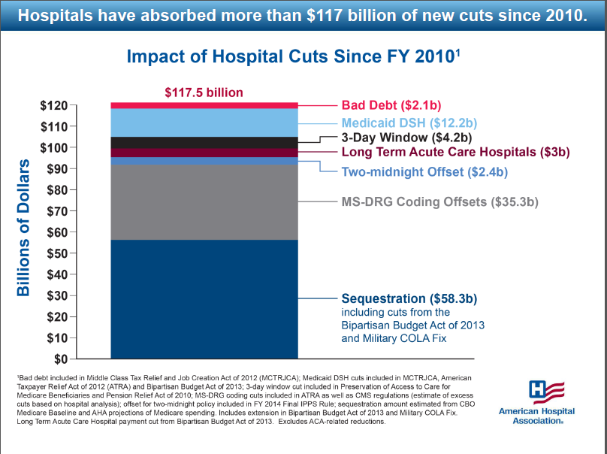

Slide 5

Medicare is in trouble
1960
Today
2030
Notes:
There are a number of factors that led us to where we are today ---
One is our aging population:
In 1960, for every person over the age of 65, there were four people under 18 coming up into the workforce to support Medicare. Today, there are just two. By 2030, there will be a single child for every adult over age 65.
Because of our longer lifespan…. And improvements in medications and medical technology, we have greater numbers of people living with chronic diseases and co-morbidities. Our health care systems wasn’t set up to deal with these issues…. Nor was it set up to keep people healthy.
SOURCE DATA
Census Year Kids for each over 65 y.o 1960 3.9 1970 3.5 1980 2.5 1990 2.1 2000 2.1 2010 1.9 2020 1.4 2030 1.2 2040 1.1 2050 1.1
Sources: http://childstats.gov/AMERICASCHILDREN/tables/pop1.asp
Population 65+ by age: 1900-2050, U.S. Bureau of the Census

Slide 6

Medicare: what’s the problem?
Why is there not enough money?
The average couple retiring in 2005 paid $140,000 in taxes over their working lifetime into Medicare—which seems like A LOT!
That average couple will get more than $390,000 in paid Medicare benefits—almost three times what they put in.

Slide 7
In Olympia: what’s the problem?
Health Care as % of total State Budget:
    1980: 6%
    1985: 12%
    1995: 17%
    2005: 24%
    2015: 33%

Slide 8
A few cost the most
National sample of 21 million insured Americans, 2003-2007
% of Total Health Care Expense
Mean Annual Cost Per Person
% Of Population
1%
29%
$101,000
9%
39%
$15,000
20%
21%
$3,700
70%
11%
$580

Slide 9
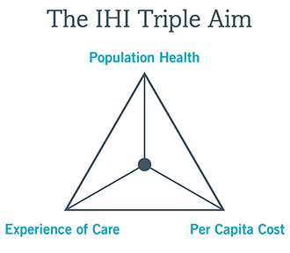
IHI’s Triple Aim (2007)
The term “Triple Aim” refers to the simultaneous pursuit of improving the patient experience of care, improving the health of populations, and reducing the per capita cost of health care.

Slide 10
The Journey from Volume to Value: Definitions
“Value” = quality/cost.
Measuring the health outcomes achieved per dollar spent.
Value-based payment is reimbursement based on indicators of value, such as outcomes efficiency, and quality.

Slide 11
Value-based Payment Continuum
Level of Financial Risk/Reward
Value-Based Purchasing Models Aligned with Care Provider’s
Risk Management Capabilities
Capitated + PBC
Shared
Risk
Shared Savings
Bundled/
Episode Payments
Performance Based Contracts
Primary Care Incentives
Fee-for-Service
Centers of
Excellence
Performance-Based Programs
Accountable Care Programs
Degree of Care Provider Integration and Accountability

Slide 12

Primary care incentives: Definition
Enhanced payment to primary care providers for practicing to identified metrics/measures and achieving improved patient outcomes or reduced costs.

Slide 13
Primary care incentives: Competencies
Demonstrate and report quality measures (PQRS, HEDIS, ACO quality measures, etc.)
EHR data, analytics to support decision-making and action
Public reporting
Care Management
Access
Measure patient satisfaction
PCMH Attributes

Slide 14
Performance Based Contracts: Definition
A portion of payment is tied to performance on cost-efficiency and quality performance measures.
While a portion of payment may still be fee-for-service, may also be paid a bonus or have payments withheld.
Rewards providers for achieving or exceeding pre-established benchmarks for quality of care, health results and/or efficiency. Often used to encourage providers to follow recommended guidelines or meet treatment goals for high-cost conditions (e.g. heart disease) or preventive care (e.g. immunizations).

Slide 15
Performance Based Contracts: Competencies
Provider alignment
Demonstrate and report quality/outcome/cost measures
  Integrated EHR, data, analytics
  Public Reporting
Ability to assume some level of risk
Contract negotiation and management
Engage patients and coordinate care
Measure patient satisfaction

Slide 16
Bundled/Episode Payments: Definition
Bundled payment is a single payment for all services to treat a given condition or provide a given treatment.
Bundled payment asks providers to assume financial risk for the cost of services for a particular treatment or condition, as well as costs associated with preventable complications.
Payments are made to the provider on the basis of expected costs for clinically defined episodes that may involve several practitioner types, settings of care, and services or procedures over time.

Slide 17

Bundled/episode payments: Competencies
Provider alignment
Demonstrate and report quality/outcome/cost measures.
  Integrated EHR, data, analytics
  Standards for appropriateness, evidence-based practice, patient experience, patient safety and affordability
  Public Reporting
Ability to assume some risk
Contract negotiation and management, including aggregation of claims into a single file.
Strong clinical relationships and ability to share data with other providers for services in the bundle.

Slide 18
Shared Savings: Definition
Offers incentives for providers to reduce health care spending for a defined patient population by offering them a percentage of net savings realized.
One-sided or two-sided models:
    One-sided or upside only models entail no performance risk.
    Two-sided or upside-downside models require providers to share in the financial risk by accepting some accountability for costs. Two-sided models however often give providers an opportunity to receive proportionately larger bonuses.
Shared savings programs also generally include some form of quality measurement.
  Providers are assessed against an agreed upon, generally nationally accepted, set of performance measures that include some combination of clinical process measures, outcome measures, and patient experience.

Slide 19
Shared Savings: Competencies
Same as bundled:
Provider alignment
Demonstrate and report quality/outcome/cost measures
  Integrated EHR, data, analytics
  Standards for appropriateness, evidence-based practice, patient experience, patient safety and affordability
  Public Reporting
Ability to assume some risk
Contract negotiation and management, including aggregation of claims into a single file
Strong clinical relationships and ability to share data with other providers for services in the bundle.
PLUS: Management of defined population

Slide 20
Population Health.. A tool to achieve volume to value
Relatively new concept (defined in 2003)
Keys to success
  The health outcomes of a group of individuals, including the distribution of such outcomes within the group.
  Includes health outcomes, patterns of health determinants, and policies and interventions that link these two.
  Population health could provide an opportunity (via shared savings for funding in the future).
Buy-in from clinicians and staff.
Patient engagement.
Seamless care transitions.
Access to, and utilization of real time data to identify, drive, and sustain performance.

Slide 21

Population Health Requires A Look Way Upstream…
Episodic Care
Case Management or Care Coordination of Select Patients
Community Behaviors and Social Determinants

Slide 22
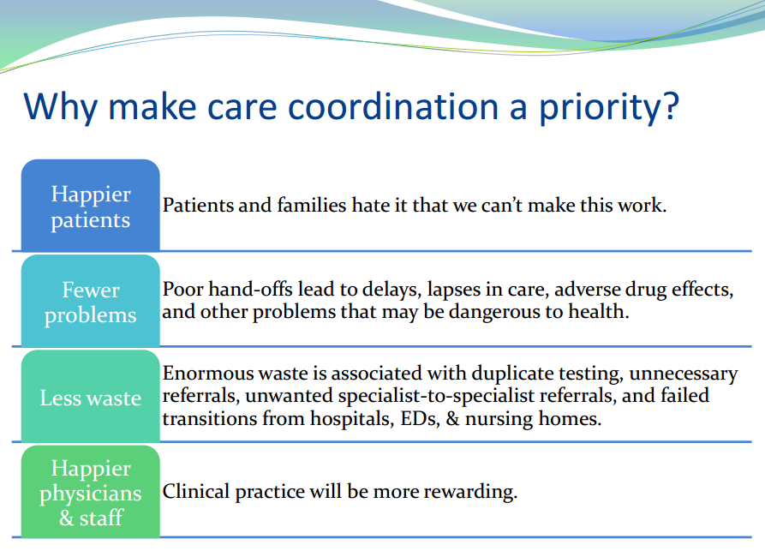
Episodic care is increasingly a dinosaur.
Source: http://www.safetynetmedicalhome.org/sites/default/files/Webinar-Closing-Loop-Referral-Management.pdf

Slide 23
Social determinants are more important than clinical care.
Health Outcomes
Mortality (Length of Life) 50%
Morbidity (Quality of Life) 50%
Health Factors
Health Behaviors 30%
Clinical Care 20%
Social and Economic Factors 40%
Physical Environment 10%
Policies and Programs
Tobacco Use
Diet & Exercise
Alcohol Use
Sexual Activity
Access to Care
Quality of Care
Education
Employment
Income
Family & Social Support
Community Safety
Environmental Quality
Built Environment
Source: University of Wisconsin Population Health Institute, 2012

Slide 24

Washington’s Medicaid Transformation in a single-bite:
Taking a population health approach
Using data to improve care
Ensuring an effective health care workforce
Integrating physical and behavioral health
Rewarding high quality care

Slide 25
Physicians are affected by move to value-based care, and they have great influence on the cost and quality of care.
Deloitte’s 2016 Survey of US Physicians found:
Little focus on value in physician compensation.
Physicians generally reluctant to bear financial risk.
Physicians conceptually endorse some of the principles behind value-based care, such as quality and resource utilization measurement.
The survey found:
Financial incentives have not kept pace.
  86% of physicians reported being compensated under fee-for-service (FFS) or salary arrangements.
  50% of physicians reported performance bonuses less than or equal to 10% of their compensation, and one-third were ineligible for performance bonuses.
Tools to support value-based care vary in maturity and availability.
  While three in four physicians have clinical protocols, only 36 percent have access to comprehensive protocols (that is, for many conditions).
  Only 20 percent of physicians receive data on care costs.

Slide 26
System/Hospital responsibilities in support of physicians:
Lowering costs, improving quality and managing patient experiences is the trifecta.
Clinical processes must be led by clinicians skillful in leadership, process improvement, information, financial management and decision-making
Equip physicians with the right tools to help them meet performance goals: Data and decision-support tools should be available, easy to use and offer the appropriate level of detail.
Invest in technology capabilities to connect and integrate the tools: Information should be timely, reliable, and actionable.

Slide 27
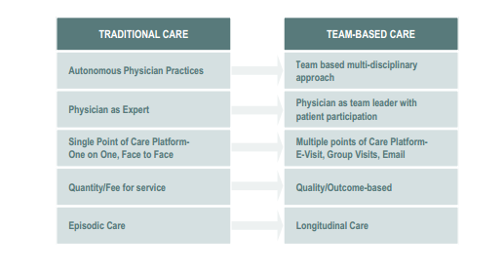
Primary care is changing…
Source: Design Considerations for Collaborative Care
The Physical Environment of a Patient-Centered Medical Home, Boulder Associates

Slide 28
Models focused on access are at the epi-center:
Basic Access Principles for All Settings:
  Immediate engagement and exploration of need at time of inquiry.
  Patient preference on timing and nature of care invited at inquiry.
  Need-tailored care with reliable, acceptable alternatives to clinician visit.
  Surge contingencies in place to ensure timely accommodation of needs.
  Continuous assessment of changing circumstances in each care setting.

Slide 29
Other best primary care practices:
Open access/same-day scheduling
Walk-in care
Team-Based Approach to Scheduling in Primary Care
Technology-Based Alternatives to In-Person Primary Care Visits
Service Excellence

Slide 30
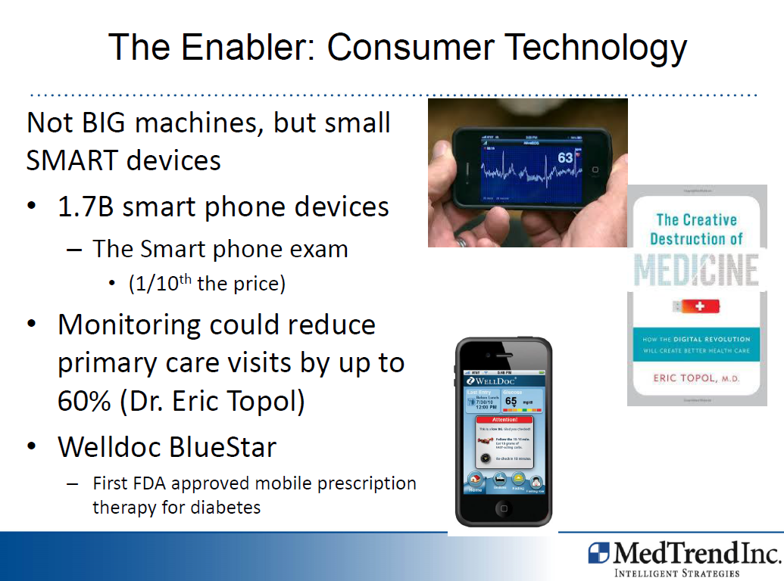

Slide 31


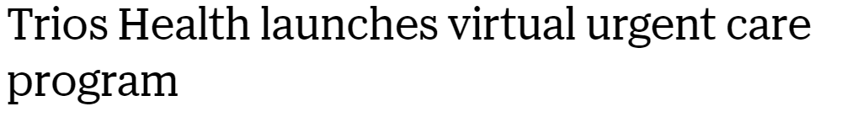
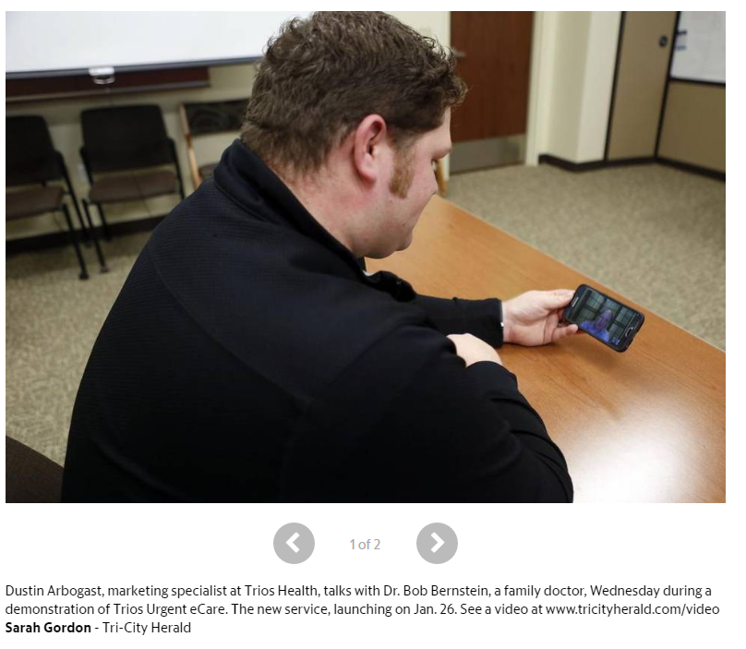
Virtual care… happening everywhere

Slide 32
“I AM IN FAVOR OF PROGRESS; IT’S CHANGE I DON’T LIKE.”
Mark Twain

