Slide 1
Social Media Dos and Don’ts
Richard Loomis | WAMSS 2017

Slide 2
Agenda
Introduction
Social Media History
Do - Social Media Safety
Do - MANNERS
Don’ts
Quiz Time

Slide 3
Introduction
About Me
vCIO and General Manager – ISOutsource
22 years of experience in IT
Social Media user since 1997
About this Presentation
This presentation will cover basic security best practices for social media.
This presentation will cover proper behavior for professionals and corporate social media users.
This presentation will be interactive, and audience participation is encouraged!
Notes:
May require more than one slide

Slide 4
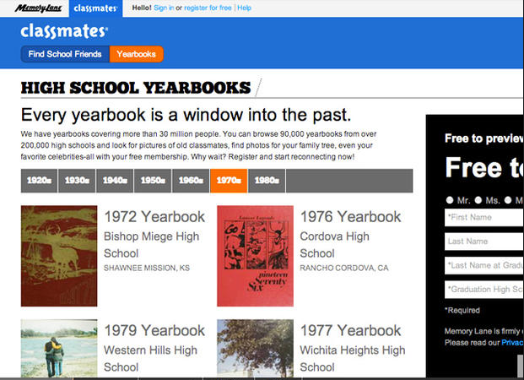
History of Social Media
Classmates
Created by Randy Conrads
Launched December 1995
Originally launched as a list of school affiliations
Later incorporated profiles and friends lists

Slide 5
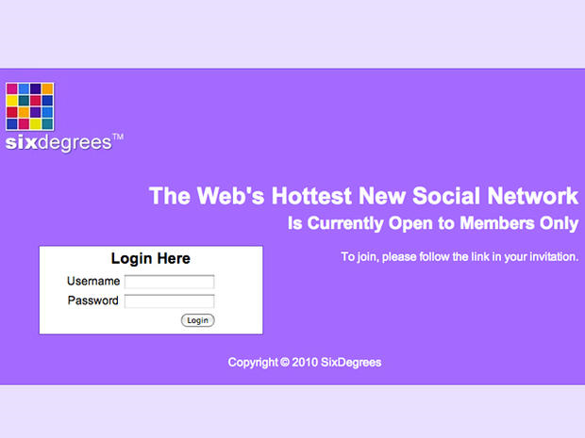
History of Social Media
Six Degrees – 1st recognized Social Media site
Created in 1996 by Andrew Weinreich
Launched in 1997
Contained profiles, friends lists, and school affiliations
The Internet wasn’t ready

Slide 6
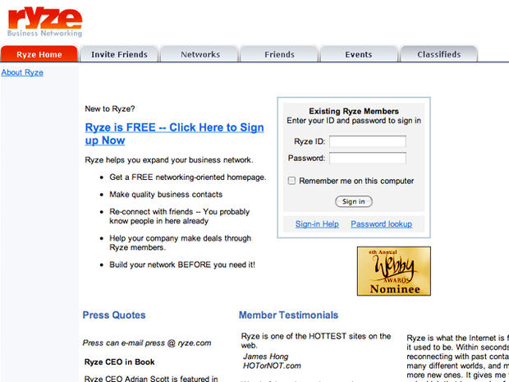
History of Social Media
Ryze
Created by Adrian Scott in early 2001
Launched in October 2001
Contained profiles, friends lists, and messaging
Precursor to LinkedIn

Slide 7
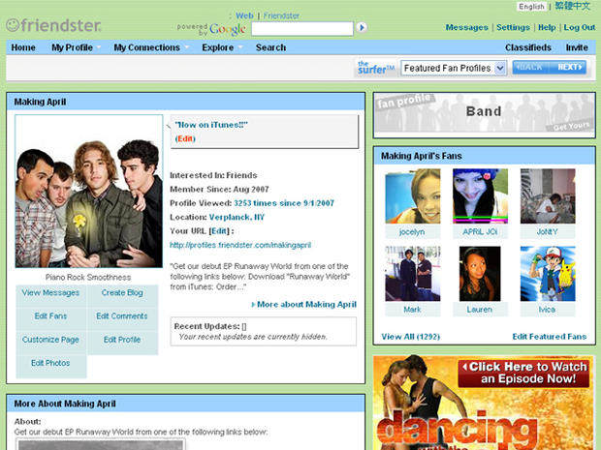
History of Social Media
Friendster
Launched in March 2002
Created by Jonathan Abrams & Peter Chin
1st truly successful site
Built on premise that people are only separated from each other by 6 degrees at most
1st dating site (not the focus)
Network couldn’t keep up with demand

Slide 8
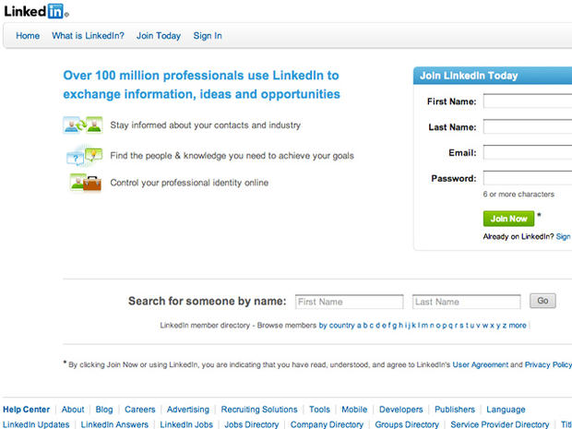
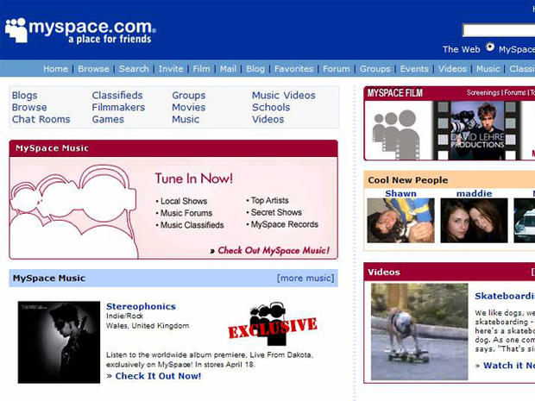
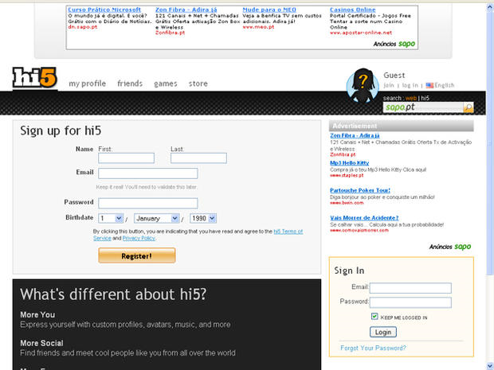
History of Social Media
2003 – What a year!
LinkedIn - May
Hi5 - June
Myspace - August

Slide 9
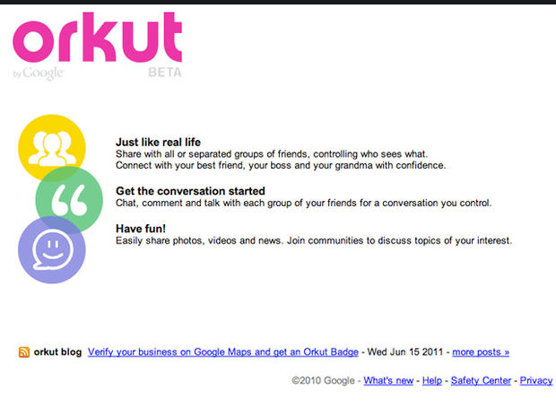
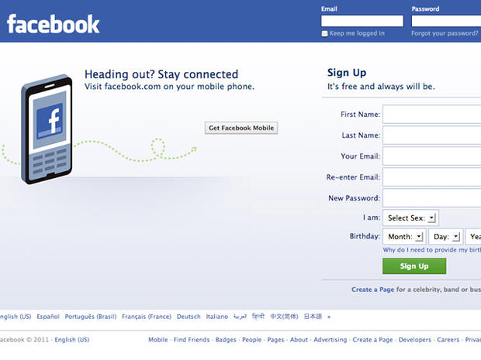
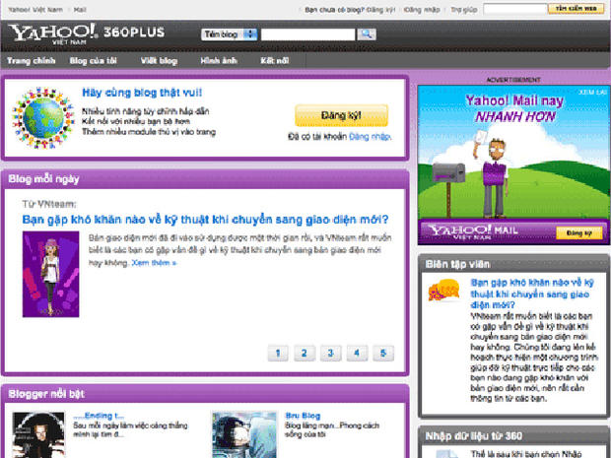
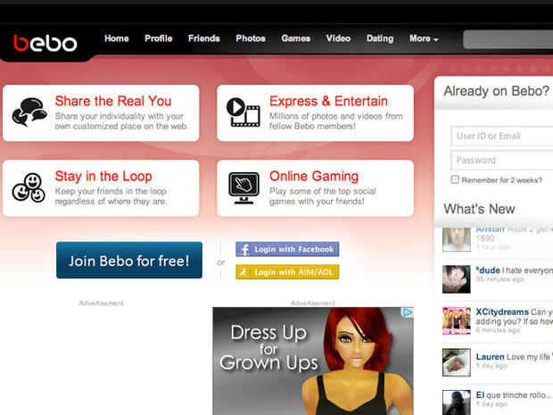
History of Social Media
Orkut by Google – January 2004
Facebook – February 2004
Yahoo! 360 – March 2005
Bebo – July 2005
Purchased by AOL for $850M
Sold for $10M

Slide 10
History of Social Media
Social Media Today
2.34 billion users worldwide
Estimated to reach 3 billion by 2020
$1T+ in market value
Estimated to reach $35.98B in advertising revenue in 2017 (16% of digital ad spending)

Slide 11
Do - Social Media Safety
Dangers of Social Media
Cyber Stalkers
Predators
Hackers
Social Engineering

Slide 12
Do - Social Media Safety
Keep your account secure
Strong password
Multi-Factor Authentication (MFA/2FA)
Select 3rd party applications with care
Keep your computer updated (operating system & A/V)

Slide 13
Do - Social Media Safety
Geotagging of photos
Checking in
Do you really know your friends?
Watch what you share

Slide 14
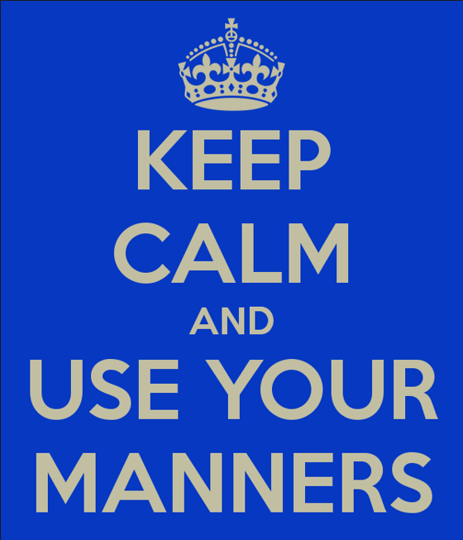
Do - MANNERS
M - Make others feel comfortable
A – Acknowledge others
N – Never speak badly of others
N – Nice mannered people succeed
E – Etiquette principles are respect, consideration, and honesty
R – Respect other people
S – Speak from the heart, Speak honestly

Slide 15
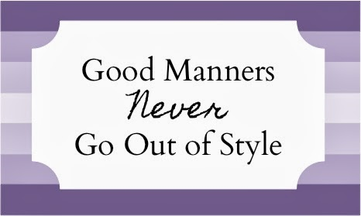
Do - MANNERS
How does this apply to Social Media?
M - Make others feel comfortable
DON’T USE ALL CAPS
No stalkers allowed!
A – Acknowledge others
Reply, like, retweet, or pin
Don’t just “walk” by
N – Never speak badly of others
What you post online never goes away
Would I say this to their face?
N – Nice mannered people succeed
Your reputation matters
The Internet remembers
E – Etiquette principles are respect, consideration, and honesty
Would I want my mother to see this?
“Listen” then speak
R – Respect other people
Online networks are more diverse then your own
Leave the profanity in private
S – Speak from the heart, Speak honestly
User your head
Think before you post or tweet

Slide 16
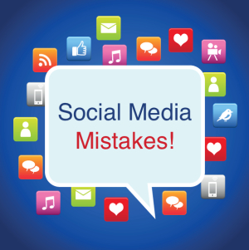
Don’t…
Post other people’s good news
Post unconfirmed rumors
Post your deepest desires
Share off-color jokes
Share private information

Slide 17
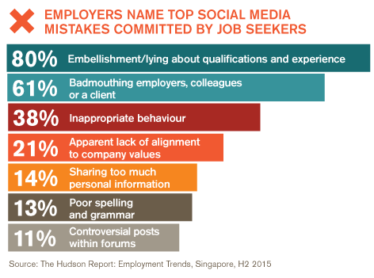
Don’t…
Post things that could impact your career or employer
Share links you haven’t vetted
Say things you wouldn’t say to someone’s face
Misrepresent yourself
Post content on the wrong media

Slide 18
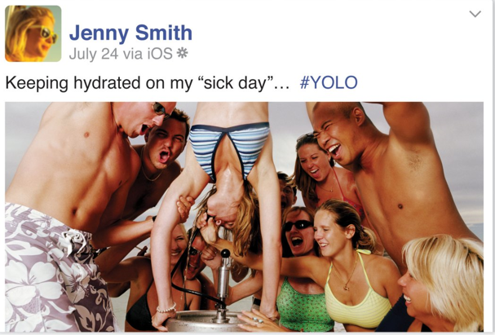
Quiz Time
Do or Don’t?

Slide 19
Quiz Time
Do or Don’t?

Slide 20
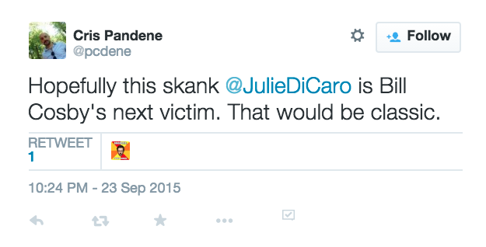
Quiz Time
Do or Don’t?

Slide 21
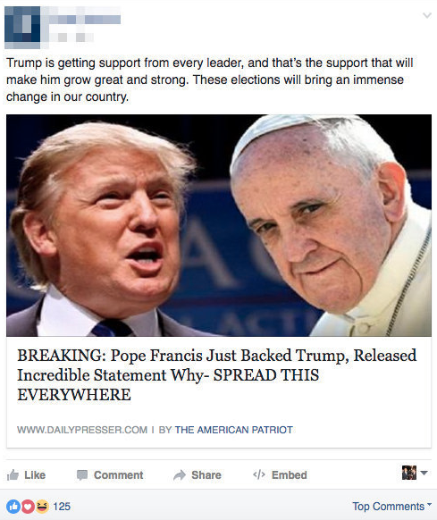
Quiz Time
Do or Don’t?

Slide 22
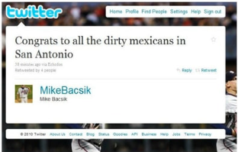
Quiz Time
Do or Don’t?

Slide 23
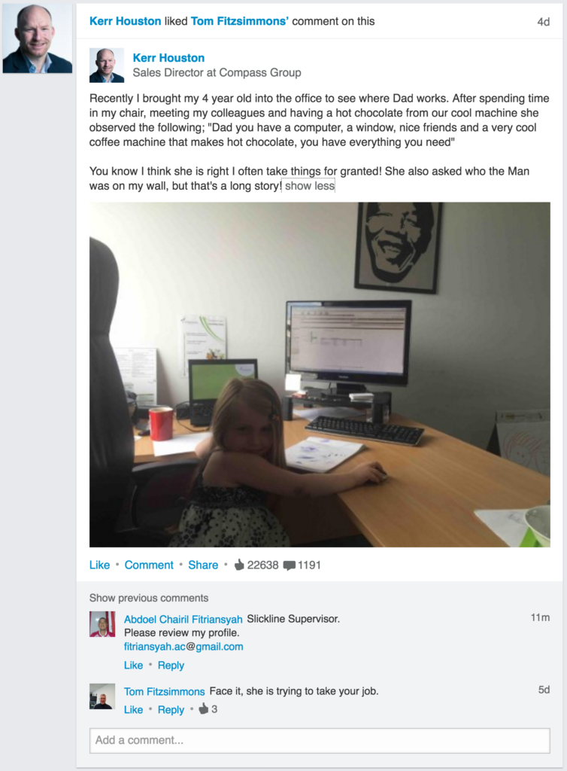
Quiz Time
Do or Don’t?

Slide 24
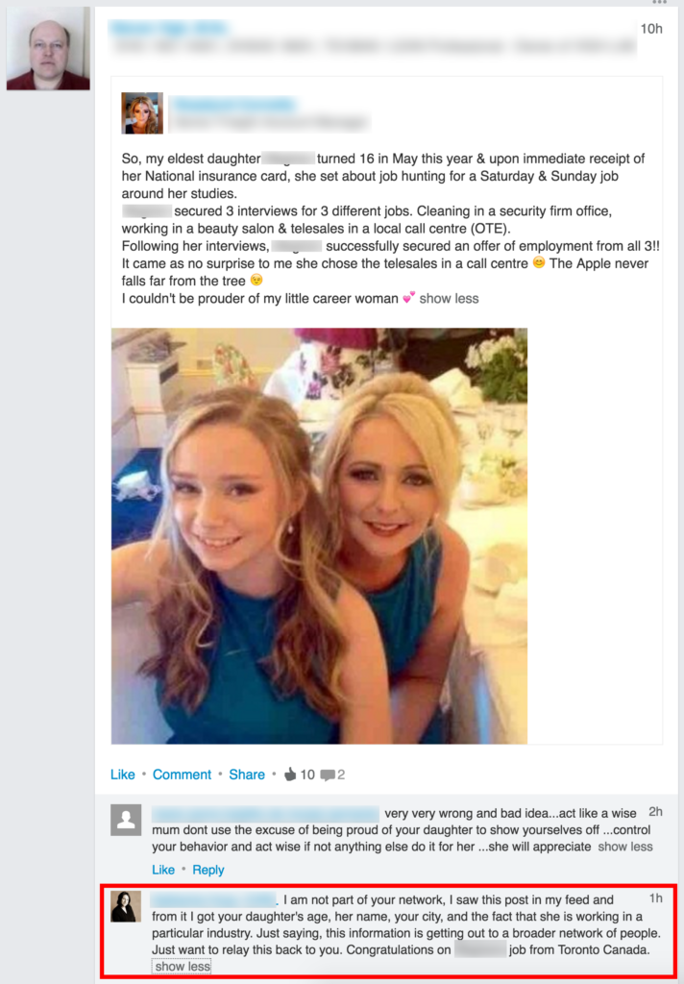
Quiz Time
Do or Don’t?

