Slide 1
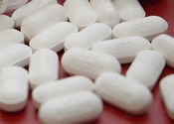
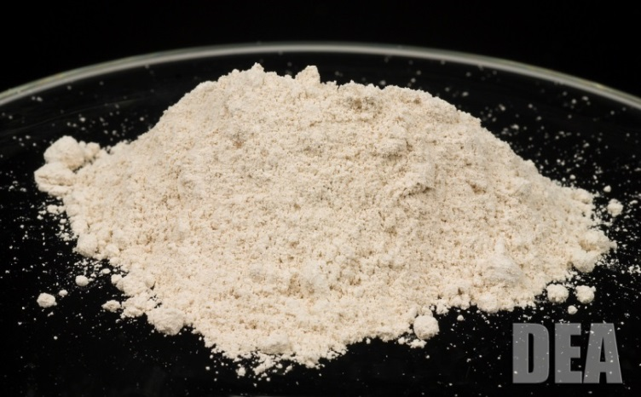

DEA Provider Case Studies, Hospital Risk Mitigation and Credentialing Brief
Washington Association of Medical Staff Services Annual Conference
April 24, 2019

Slide 2
Who I Am
Retired DEA Special Agent in Charge - Chicago.
30 years of experience.
Worked through the Indiana “pill mill” crisis during 2005 through 2014.
Have been partnering with medical community/prescribers for last 10 years through controlled substance programs.
Developer of CME and CLE prescription drug risk mitigation programs focusing on prescriber safeguards, DEA compliance, MAT, pain and drug destruction.

Slide 3
Disclosure Statement
This is to confirm that I do not have any personal financial or commercial affiliation to this subject matter.
This is not a promotional talk for any pharmaceutical company.
I will not discuss off-label/investigative use of any commercial product.

Slide 4
Presentation Outline
82 Slides – 40 minutes
Provider studies
Provider case studies
Hospital risk and case studies
Medical office risk and case studies
Credentialing tips
Drug updates
What else?
Q & A – 20 minutes

Slide 5

Medical Provider Risk

Slide 6
Medical Provider Study #1

Slide 7
PAIN MEDICINE
Physicians Charged with Opioid Analgesic-Prescribing Offenses
Volume 9, Number 6, 2008
Study undertaken by Center for Bioethnics in partnership with the National Association of Attorneys General and the Federation of State Medical Boards
Case review period, 1998 - 2006
725 doctors representing 0.1%
Source: https://michigan.gov/documents/mdch/Pain_Medicine_Study.Sept08_270281_7.pdf

Slide 8
Specialty of Physicians Involved in Criminal and Administrative Cases
Speciality | %
General Practice | 39.3
Physical medicine | 2.7
Pain medicine | 3.5
Psychiatry | 8.1
Internal medicine | 23.7
Anesthesiology | 7.5
Emergency medicine | 5.3
General Surgery | 5.1
Obstetrician/Gynecologist | 3.2
Pediatrics | 2.9

Slide 9
Physicians Involved in Criminal and Administrative Cases
Gender | %
Male | 89.4
Female | 10.6
Age Range | %
35 & under | 3
35 – 44 | 18.1
45-54 | 39.5
55-64 | 24
65 + | 15.5

Slide 10
Case Outcomes
 | %
Plead Guilty or No Contest | 79.5
Plead Not Guilty | 20.5
Plead Not Guilty | %
Found guilty or susequently plead | 90.6

Slide 11
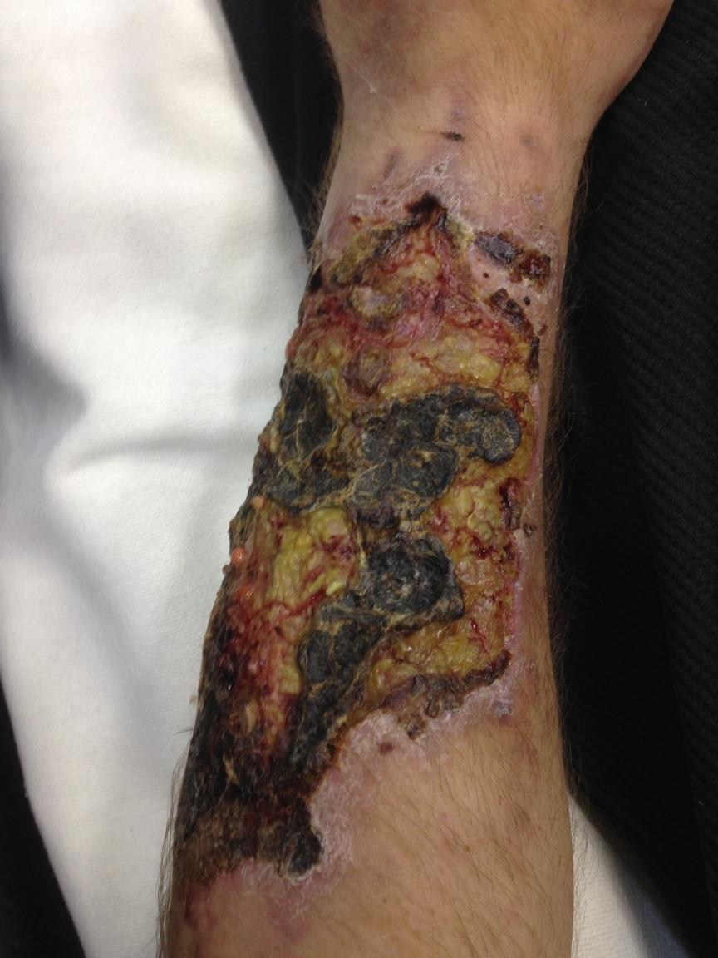
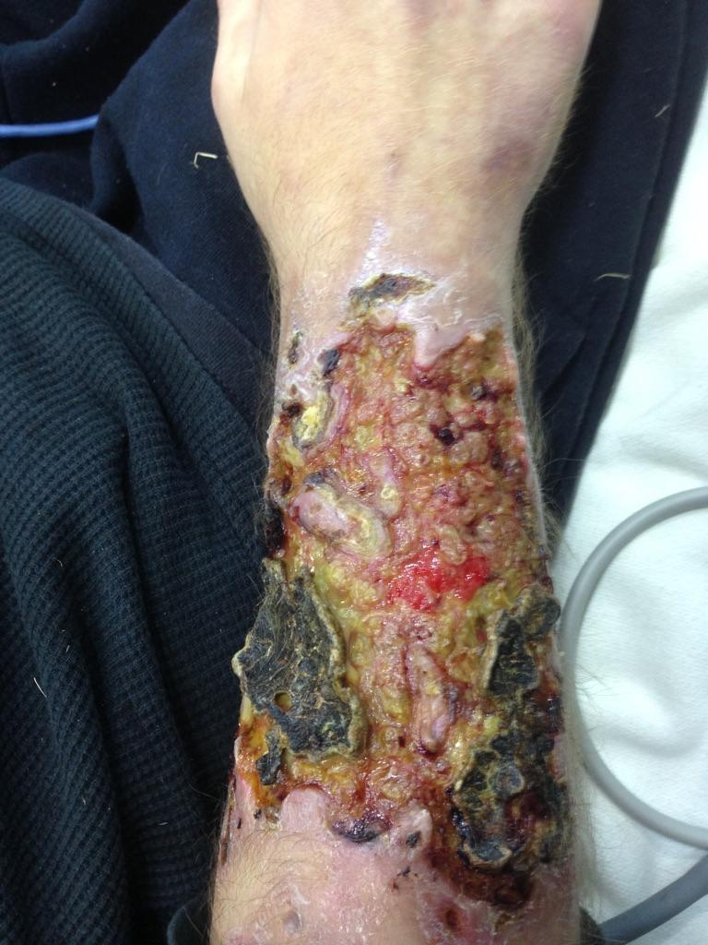
What Drug Causes This?
Source: Walworth County, WI SO Drug Unit

Slide 12
Extreme Heroin Use & Needle Use
Source: Walworth County, WI SO Drug Unit

Slide 13
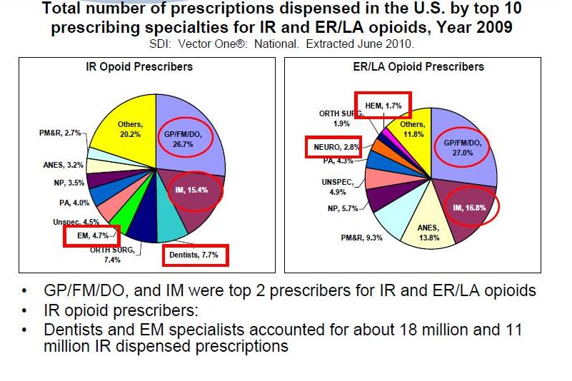
www.fda.gov/downloads/AdvisoryCommittees/CommitteesMeetingMaterials/Drugs/
AnestheticAndLifeSupportDrugsAdvisoryCommittee/UCM220950.pdf page 16

Slide 14
Medical Provider Study #2

Slide 15
U.S. Physicians Disciplined for Criminal Activity
From HEALTH MATRIX Vol. 16:335 Summer 2006.
1990 thru 1999 date range
Criminal and medical board findings
31,110 disciplinary entries against 20,125 physicians
3,902 criminal convictions entries for 2,247 for physicians
https://www.citizen.org/our-work/health-and-safety/article-health-matrix-us-physicians-disciplined-criminal

Slide 16
U.S. Physicians Disciplined for Criminal Activity
From HEALTH MATRIX Vol. 16:335 Summer 2006.
Findings
  “Physicians disciplined for criminal offenses were older than the national physician population.”
  51.9% were 45 or older when disciplined
  70.7% were 45 or older when criminally convicted
https://www.citizen.org/our-work/health-and-safety/article-health-matrix-us-physicians-disciplined-criminal

Slide 17
U.S. Physicians Disciplined for Criminal Activity
From HEALTH MATRIX Vol. 16:335 Summer 2006.
Findings
  Physicians between 55 and 64 had highest risk ratio.
  General practice had highest risk of 4.93
  Psychiatry had risk of 2.24
  Family practice had risk of 1.97
  Child and adolescent psychiatry had risk of 1.75
https://www.citizen.org/our-work/health-and-safety/article-health-matrix-us-physicians-disciplined-criminal

Slide 18
U.S. Physicians Disciplined for Criminal Activity
From HEALTH MATRIX Vol. 16:335 Summer 2006.
Findings
  61.5% of all U.S. physicians are board certified – only 41.5% of disciplined physicians were board certified.
https://www.citizen.org/our-work/health-and-safety/article-health-matrix-us-physicians-disciplined-criminal

Slide 19
U.S. Physicians Disciplined for Criminal Activity
From HEALTH MATRIX Vol. 16:335 Summer 2006.
Physicians disciplined for drug-related offenses:
  General Practice & Family Practice highest
Physicians disciplined for fraud offenses:
General Practice & Psychiatry highest
https://www.citizen.org/our-work/health-and-safety/article-health-matrix-us-physicians-disciplined-criminal

Slide 20
Providers in Trouble
Case Examples

Slide 21

Dr. M
Opened one provider pain clinic
ISO and search warrant took him out
Open until 6 am in morning
Fired from hospital
In 50’s
Internal medicine
Major city

Slide 22

Dr. H
One provider pain clinic
Cash only
Cell phone appointment
Other patient referral only
Psychiatrist
In 50’s
Major city

Slide 23





W Clinic
Death Focused 27+: been at a long time – started from coroner
Family practice providers and three PA’s
Involved numerous pre sign prescriptions
One provider had been fired from local hospital
Five males & one female
All 50 plus

Slide 24

Dr. R
One provider office
Trained in Nigeria
Family practice
Pain clinic
Near 50
Sexually assaulted 30 plus women
ISO’ed
Pleaded guilty 4/2014
10 years

Slide 25
“U.S. Medical Regulatory Trends and Actions”
Federation of State Medical Board Study
2018 Year Data
970,090 active physicians
4,081 physicians disciplined
Surrendered 570
Revoked 264
Denied 97
Total 931
https://www.fsmb.org/siteassets/advocacy/publications/us-medical-regulatory-trends-actions.pdf

Slide 26
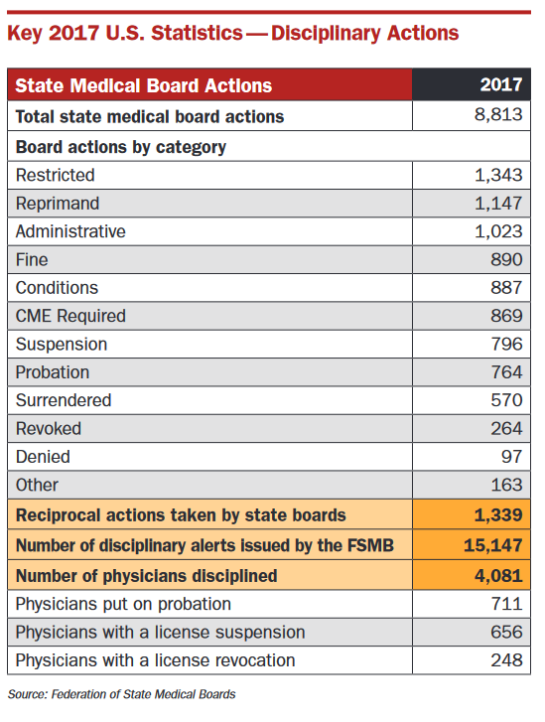
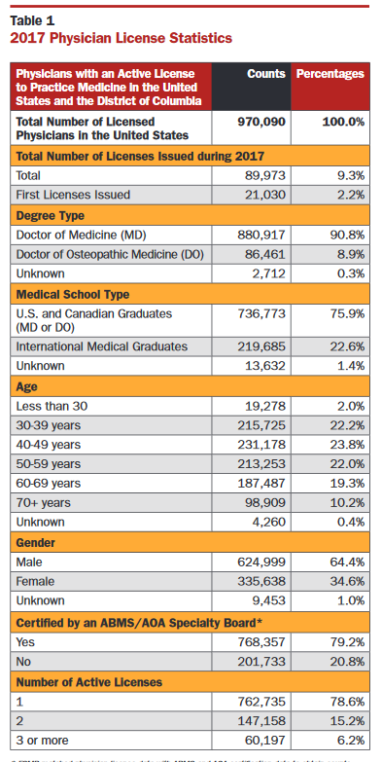
“U.S. Medical Regulatory Trends and Actions”
Federation of State Medical Board Study
2018 Year Data
https://www.fsmb.org/siteassets/advocacy/publications/us-medical-regulatory-trends-actions.pdf

Slide 27
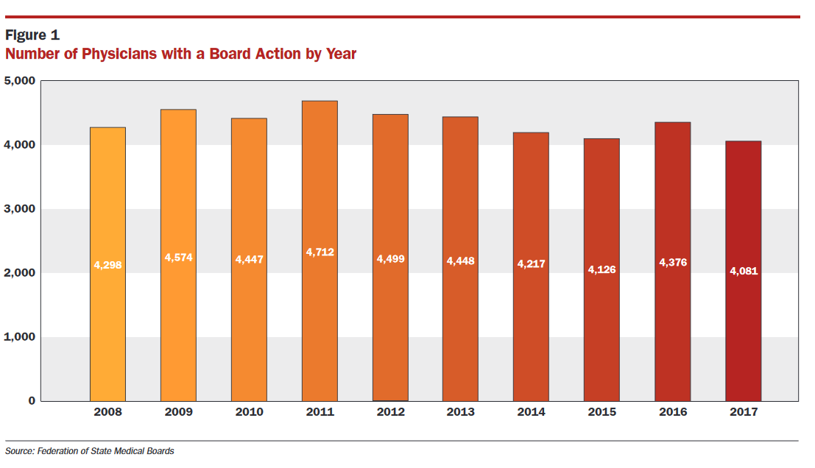
“U.S. Medical Regulatory Trends and Actions”
Federation of State Medical Board Study
2018 Year Data
https://www.fsmb.org/siteassets/advocacy/publications/us-medical-regulatory-trends-actions.pdf

Slide 28
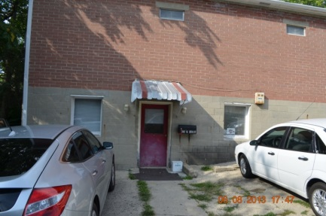
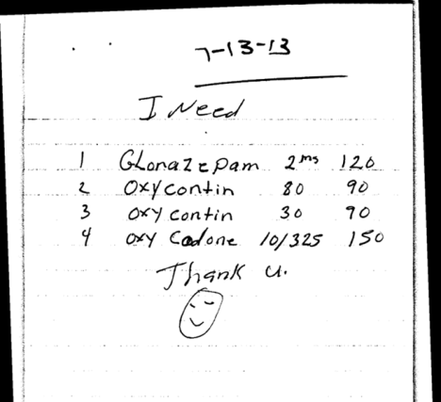
Dr. B
One provider office
Family practice
Four overdose deaths
50 plus
Surrendered his license
Also a weight loss provider
Suburb of large city

Slide 29
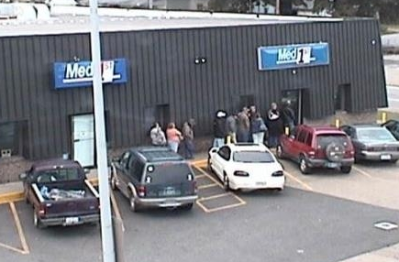

Med 1st
Chiropractors and Doctor
One family practice provider
Several NP’s
Two chiropractors - managers
Medicaid patient focused
All 50 plus
Large city
Focused on back injections

Slide 30

Dr. W
Family practice
50 plus
Law enforcement complaints
Hospital affiliated
Later forced to retire
Rural area
Naive

Slide 31
MCCHC
Federally funded health clinic
Rural city
Family practice provider
84 years old
Two rookie PA’s
Hundreds of pre-signed scrips to PA’s
Managed by non-medical CEO
Nine overdose deaths
Reimbursed $115 per poor patient
Voluntary surrender

Slide 32
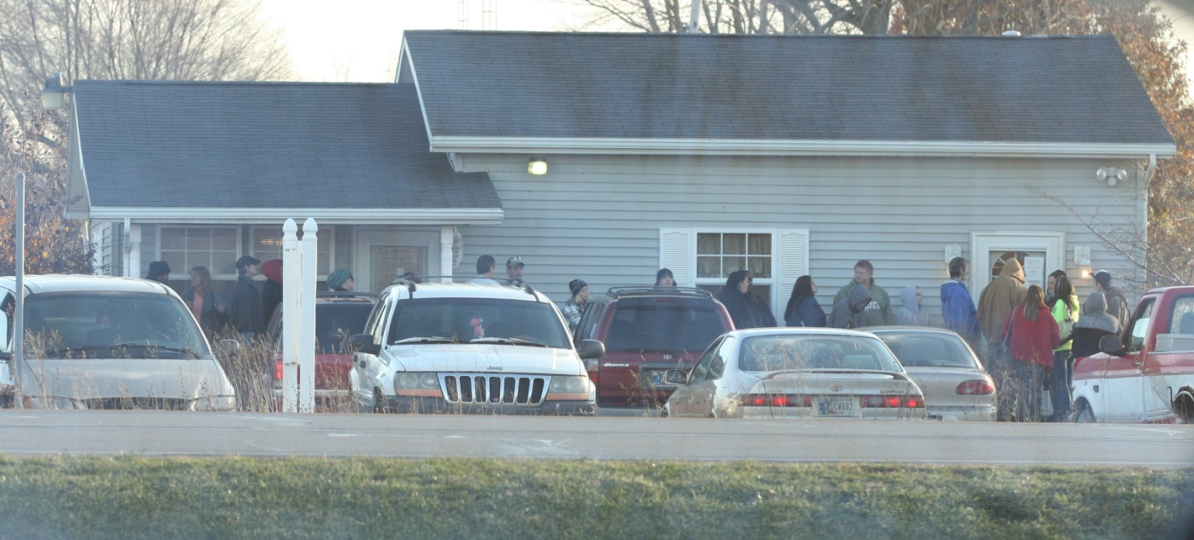
Indiana Pill Mill

Slide 33
Hospital Investigations
What do we see?
Nurses/doctors self abusing liquid painkillers from patients
Do not see significant practitioner issue in hospitals due to management oversight, policies & peer pressure
Controlled substance thefts and diversion – Usual cause is poor oversight of drugs in pharmacies

Slide 34
Most Common Hospital Risk
Case Example #1
Hospital
  Provider/nurse diverting drugs for self-abuse
    (Painkiller/benzo)
  Distribution? Bar raised
Risk mitigation
Get in treatment asap to mitigate
Protect licenses if possible
Diversion of liquid drugs – most common
Fentanyl/morphine to saline
Due diligence & policies
Notification?
      LE
      Boards
Take action - Colorado
Maintain “rule of two” over CS’s to mitigate

Slide 35
Hospital Risk
Case Example #2
Large Hospital – $250,000 dollar fine
Diversion of 96,000 oxycodone tablets by nurse at cancer center
Nurse would draft prescriptions and get signed by providers and she would get filled at in-house pharmacy “to help patients”
No due diligence by pharmacists

Slide 36
Hospital Risk
Case Example #3
Large Hospital – One million dollar fine
Only one pharmacy was registered. (Hospital had multiple pharmacies at different addresses. All sites must be registered.)
Invoices for drugs were not kept on-site for two years. (Had been destroying them.)
No biennial inventory conducted. (Lack of records.)
Drugs were being destroyed but no destruction records. (DEA 41 forms required & options to destroy. Employee destroying by himself in alcohol)
Poor security (significant theft – multiple employees had keys for CS access. Local DTF made DEA aware of drugs on street.)
$10,000 CFR fine per violation

Slide 37
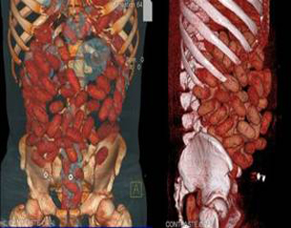
What is this?

Slide 38
X-Ray of Cocaine Pellet Body Carrier

Slide 39
Hospital Risk
Case Example #4
Large Hospital
Fined $2.3 million
Nurses stealing drugs – 14,000 oxycodone tablets from ADM (had been falling asleep at work)
Had not been keeping ADM’s access up-to-date
No supervisory review of ADM usage
Multiple diversion of drugs by nurses with no discipline
Loose control over CSs – some brought to lunch room
Corrective Action Plan
Establish FT Drug Diversion (DD) Compliance Officer
Establish DD Team – CO, pharmacy, nursery & police/security
Annual training
Instituted ADM software
Limited access to drug vault & server to pharmacists and techs
Instituted daily and weekly reviews and audits of drug usage

Slide 40
Most Common Medical Office Risk
Case Example
Risk mitigation
Prescribe only - if possible
Prescribing vs dispensing
Dispensers must maintain records
CS’s must be stored in “securely locked, substantially constructed cabinet or safe”
Limit access to CS’s
Use pharmacist if possible
Should small offices not maintain CS’s?
Medical office
  Office provider dispensing CS’s without maintaining required records
  Office maintaining CSs without proper security and recordkeeping

Slide 41
Other Healthcare Risk
What do We See?
Healthcare practitioners paid by # of patients seen & tied to CS prescriptions.
Prescriptions sometimes tied to back injections
Rural more than urban settings
Almost always involves older male doctors, 45 yoa +
Sex for drugs on some occasions

Slide 42
Pharmacy Investigations
What do we see?
Controlled substance thefts and diversion by pharmacy techs.

Slide 43
Ambulance Service Investigations
What do we see?
EMT personnel self abusing liquid painkillers from kits.
Poor accounting of CS’s

Slide 44
Credentialing Thoughts
Don’t believe it unless you can corroborate it.
The power of Google
Follow national guideline, if possible if not develop one as group
Document and build file –
  “If it isn’t written, it didn’t happen”

Slide 45
DEA’s Role with Medical Providers
DEA's authority under the CSA is not equivalent to that of a State medical board. DEA does not regulate the general practice of medicine.
The responsibility for educating and training physicians so that they make sound medical decisions in treating pain (or any other ailment) lies primarily with medical schools, post-graduate training facilities, State accrediting bodies, and other organizations with medical expertise.
DEA’s authority is limited to controlled substances only.

Slide 46
Credentialing Thoughts
Surrender versus administrative action. (800 a year)
DEA will notify state officials on a provider’s DEA # surrender.
DEA will usually not confirm or deny a surrender.
Check via DEA website.
All DEA administrative & criminal actions are listed at “Cases Against Doctors.”
State versus fed for timeliness.
DEA for drugs – HHS for fraud.
All medical licenses are linked.

Slide 47
Drug Updates & Emerging Trends

Slide 48
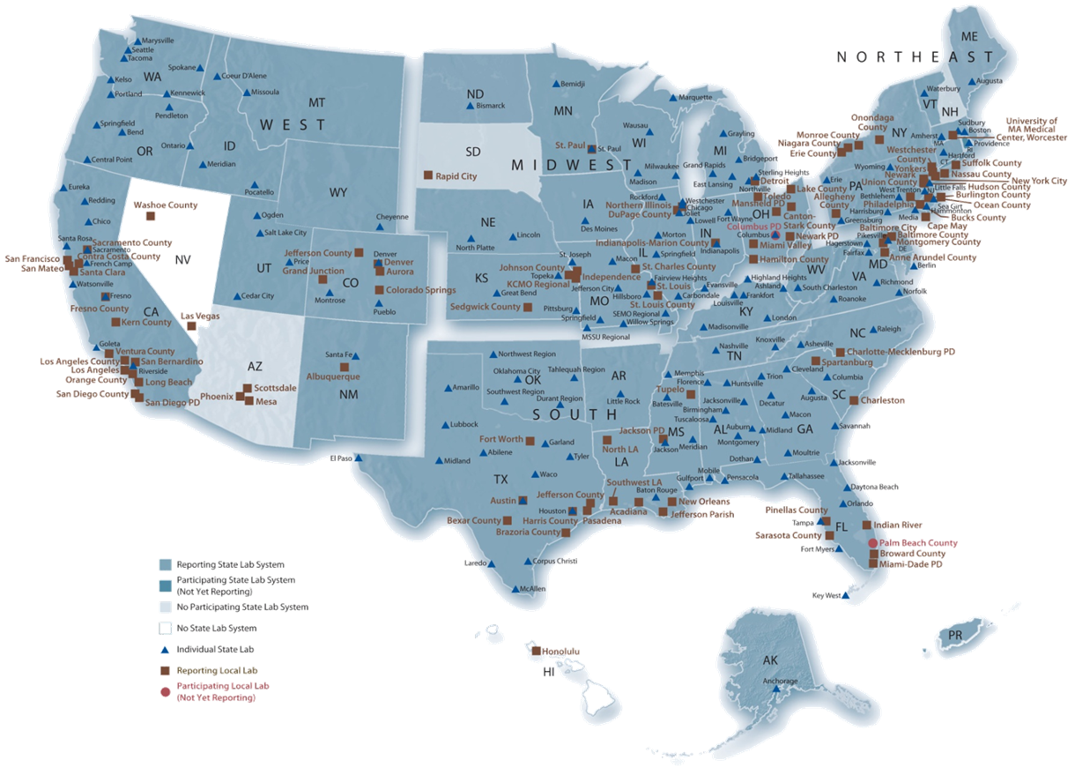
National Forensic Laboratory
Information System
NFLIS
91% all evidence from 273 participating labs from 49 states https://www.nflis.deadiversion.usdoj.gov

Slide 49
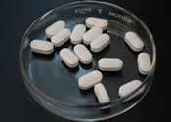
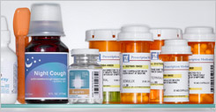
Most Commonly Abused Pharmaceutical Drugs

Slide 50
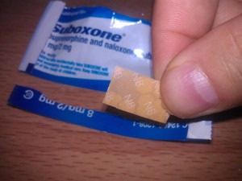
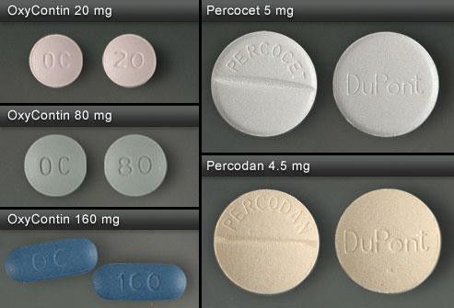
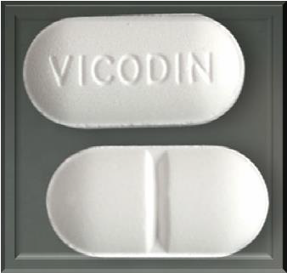

Top Five Narcotic Analgesics
Submitted to Crime Laboratories (NFLIS)
Oxycodone
(Percocet/OxyContin) 32%
Hydrocodone
(Vicodin/Lortab) | 21%
Buprenorphine (Suboxone) | 14%
Fentanyl | 11%

Slide 51
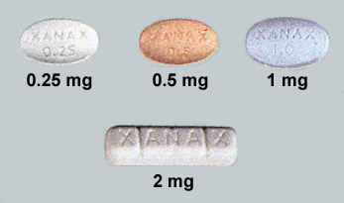
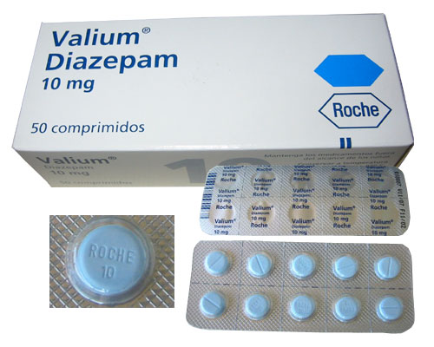
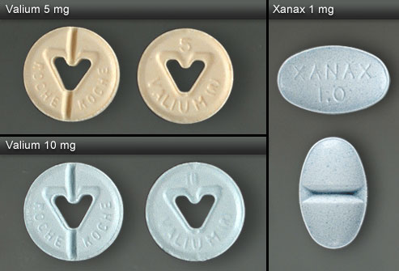
Top Three Benzodiazepines Submitted to Crime Laboratories (NFLIS)
Alprazolam (Xanax) 56%
Clonazepam (Klonopin) 15%
Diazepam (Valium) 7%
Notes:
Xanax is the most commonly abused bezodiapane encountered by law enforcement.

Slide 52
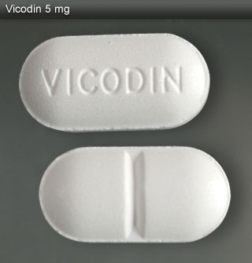
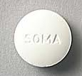
The Holy Trinity
Prescription Drug Combination that Gives Heroin - Like - High
Hydrocodone – Vicodon/Lortab/Norco
Alprazolam - Xanax
Soma - Carisprodol
No legitimate medical purpose

Slide 53
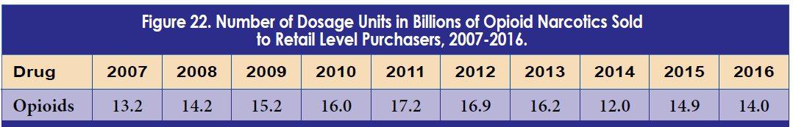
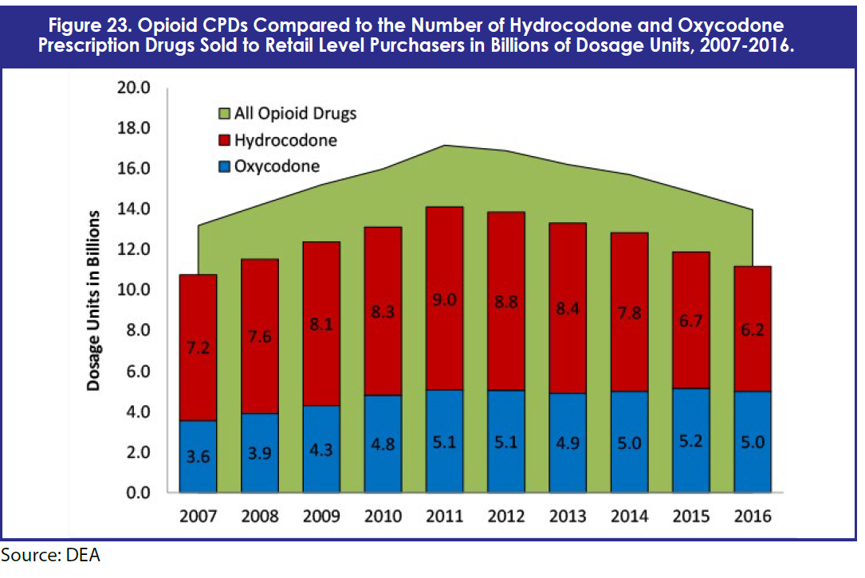
Source: DEA 2017 Drug Threat Assessment

Slide 54
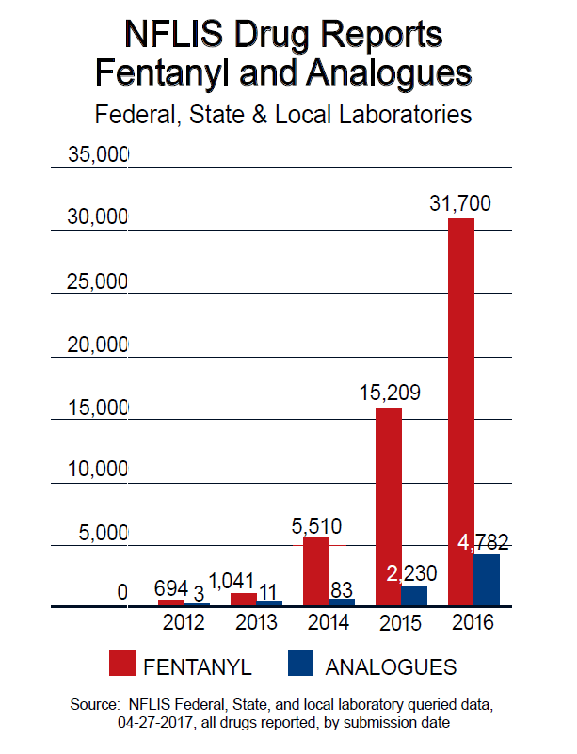
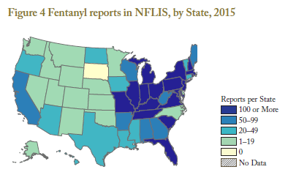
Fentanyl from China: the New Opioid Threat
https://www.deadiversion.usdoj.gov/nflis/2017fentanyl.pdf

Slide 55
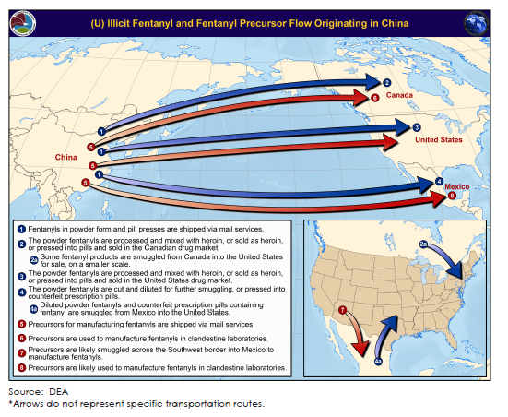
Chinese Fentanyl Flow
Source: https://www.dea.gov/docs/Counterfeit%20Prescription%20Pills.pdf

Slide 56
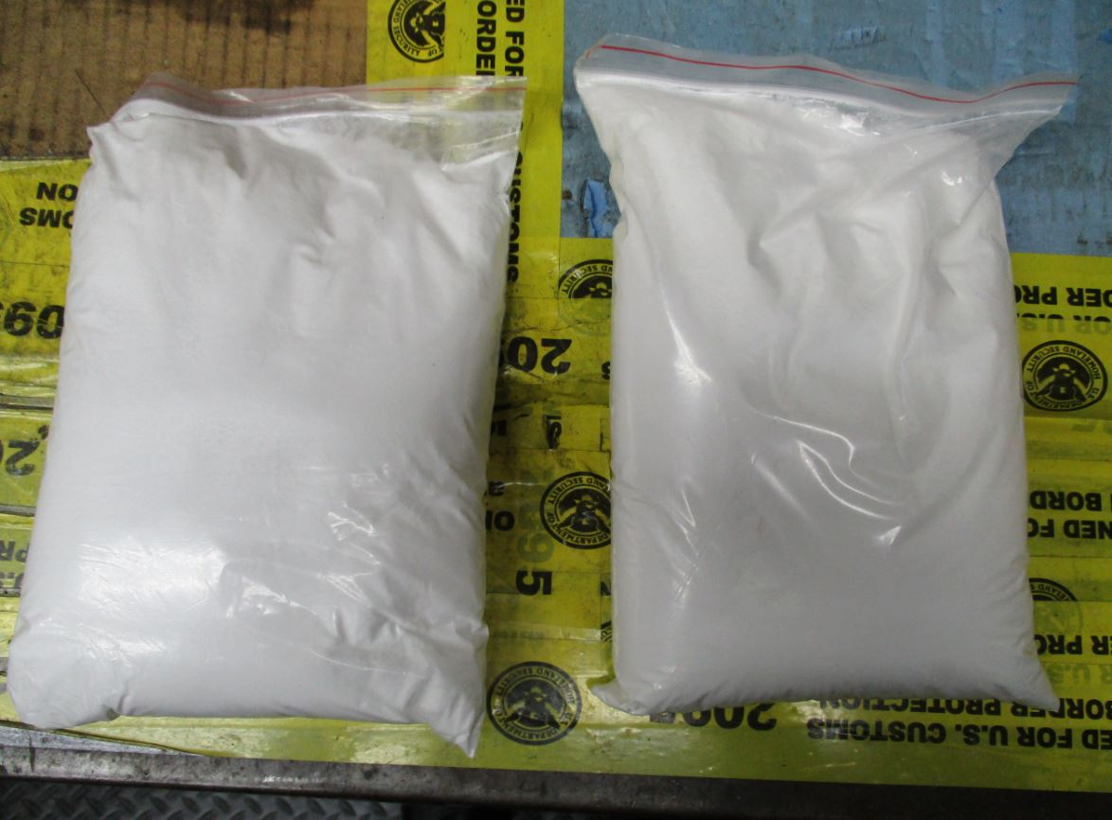
Chinese Sourced Fentanyl

Slide 57
DEA Action Against Emerging Fentanyl's
November 9, 2017
February 7, 2018
DEA announces intention to emergency schedule all fentanyl’s.
DEA emergency schedules all fentanyl’s.
Source: https://www.dea.gov/divisions/hq/2017/hq110917.shtml

Slide 58
What Else is New?

Slide 59
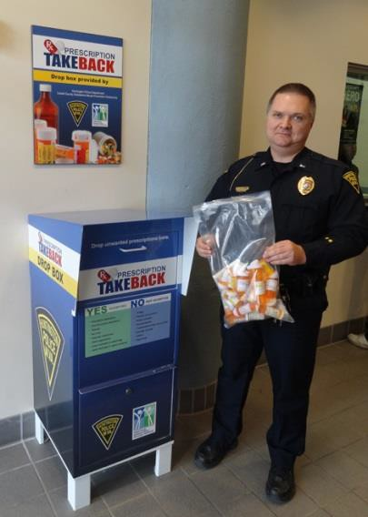
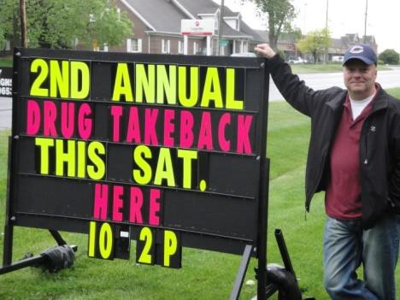
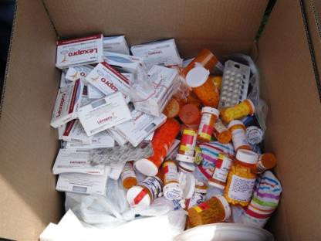
Drug Disposal Options
Take Back Days
Law Enforcement Boxes
Pharmacy Take Back “Authorized Collectors”
62

Slide 60
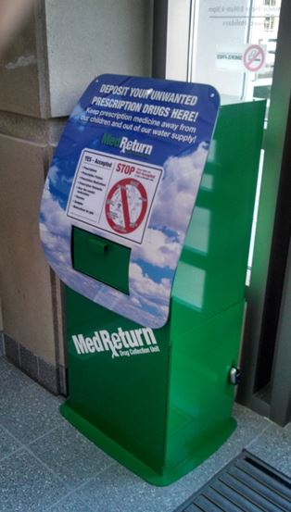
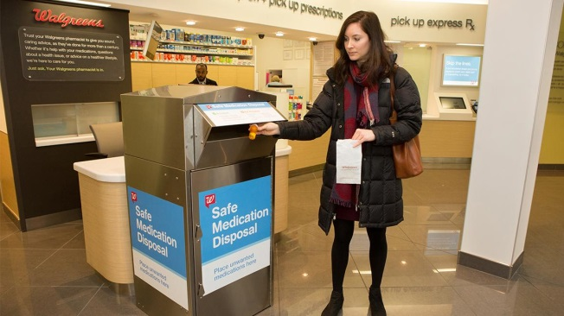
Drug Disposal Options
Kentucky
NABP www.awarerx.com (48 + locations, Floyd Memorial & Carroll Co. Memorial)
DEA https://apps.deadiversion.usdoj.gov/pubdispsearch/spring/main?execution=e1s1 (29 locations, U of L Hospital, Clark Memorial & VA Lexington)
Walgreens (multiple locations)
https://www.walgreens.com/storelistings/storesbystate.jsp?requestType=locator
CVS (multiple locations)
https://www.cvs.com/content/safer-communities-locate

Slide 61









































































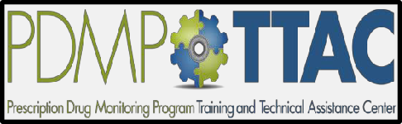











PDMP Mandatory Query by Prescribers and Dispensers
(Listing of the specific conditions for mandatory query)
VT
WA
NH
MT ND
MN
MA
OR
WI
NY RI
SD
WY
PA NJ
N
IA
DE
MP TTAC PDMP TTAC
NV
IL IN
WV _{VA}
UT
CO
MD
KS DC
CA
*MO
KY
AZ NM AR
SC
MS
AL
GA
AK
TX
LA
FL
MP TTAC PDMP TTAC PDMP TTAC PDMP TTAC
MP TTAC PDMP TTAC PDMP TTAC PDMP TTAC
MP TTAC PDMP TTAC PDMP TTAC PDMP TTAC MP TTAC PDMP TTAC PDMP TTAC PDMP TTAC
Prescribers and Dispensers (14)
Prescribers Only (24)
No Mandatory Query (14)
as of August 2017

Slide 62
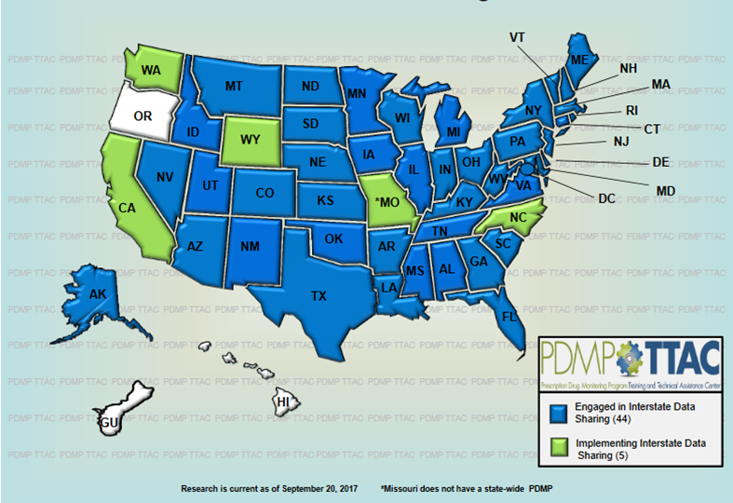
PDMP Data Interstate Sharing
http://www.pdmpassist.org/pdf/Interstate_Data_Sharing_20170920.pdf

Slide 63
Comprehensive Addiction and Recovery Act (CARA) Highlights
In effect since July 22, 2016
Qualifying physicians can treat up to 30, 100 or 275 patients
Qualifying NP’s and PA’s can treat up to 30 or 100 – for a five year period depending on state laws.
New TIP 63 out on February 15, 2018.
When in doubt – email SAMHSA.
Data Waived Physicians as of 1/2019 - SAMHSA
30 patient limit | 43,403
100 patient limit | 11,410
275 patient limit | 4,635
Total | 59,430

Slide 64
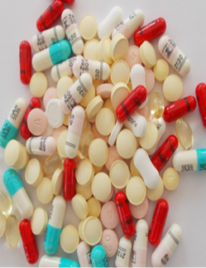
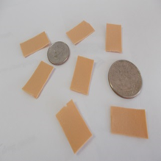
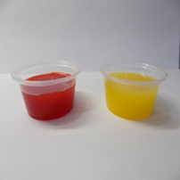
Medication Assisted Treatment (MAT) Updates
Increase of Methadone clinics tied to hospitals & health clinics
State laws & oversight of buprenorphine clinics
Mid-level MAT provider expansion

Slide 65
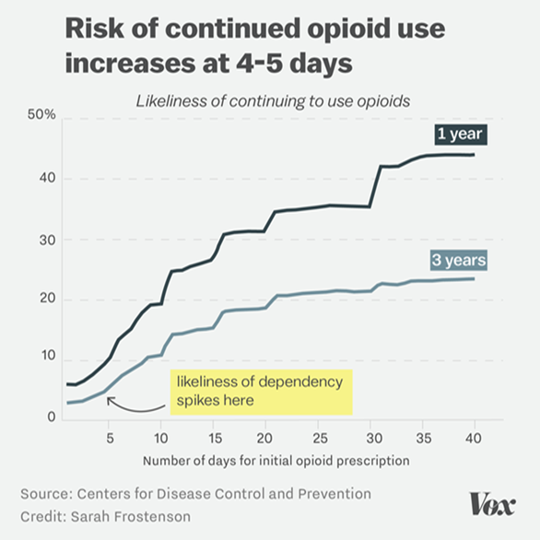

What Else Should I Know?
Emerging updates
CDC prescribing guidelines
VA Study
State laws on OME limits – amounts & days
Hospital OME limits
Increased use of naloxone due to fentanyl overdoses

Slide 66
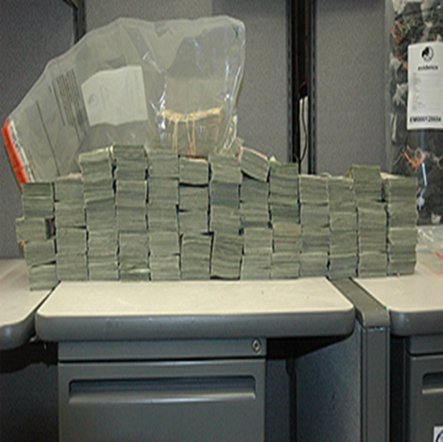
What Else Should I Know?
Emerging updates & possible risk?
What is your complaint process? (Larry Nassar – small office & little oversight?)
Importance of “rule of two”
Provider compensation tied to patients seen & CS’s raises risk
Risk relative to provider characteristics
Providers contracting with others - while employed by you

Slide 67



Community Partnerships?
Hold a Drug Take-Back Event?
Take-back events with law enforcement partnerships
Table & flyers
Mail-back programs with pharmacy oversight
Collection receptacles inside hospitals with pharmacy oversight

Slide 68
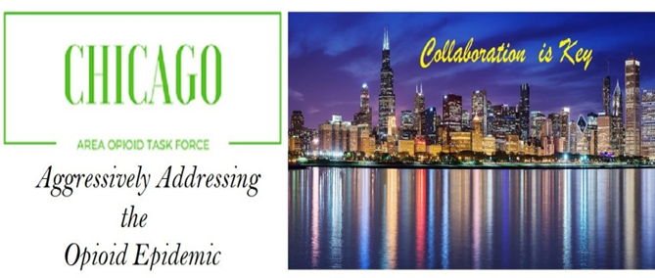
Community Partnerships?
Form a Task Force?
Treatment, hospital, school educators, law enforcement, PDMP officials, lawmakers and other groups meeting bi-monthly to better their communities.
Website with links and resources

Slide 69



Community Partnerships?
Develop Drug Prevention Programs with Schools?
Educator Lesson Plans – Drug Prevention
www.operationprevention.com
www.redribbon.org
www.robertcrown.org
Parent Drug Website
www.drugfree.org

Slide 70
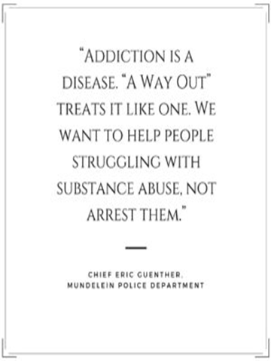
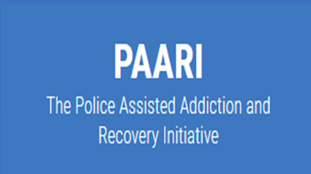
Community Partnerships?
Develop “A Way Out” Program with Law Enforcement & Treatment Providers?
“A Way Out” is a Law Enforcement Assisted Diversion pilot program, designed to fast-track users to substance abuse programs and services. This program is available 24 hours a day, 7 days a week at participating police departments and ensures no criminal charges will be sought for those that may be in possession of narcotics or paraphernalia, as long as assistance is sought out by the prospective program participant.
Also known as a “Angel Program” or Police Assisted Addiction & Recovery Initiative (PAARI)
http://awayoutlc.org/
http://paariusa.org/

Slide 71
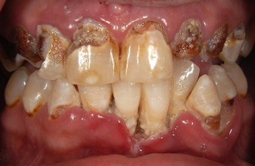
What Drug Causes This?

Slide 72
Meth Mouth
Courtesy of Dr. Stephen Wagner DDS & American Dental Association

Slide 73
Telemedicine - 21 USC 802 (54)
Ryan Haight Act - Federal
      Background
      Allows for telemedicine after a in-person evaluation
      Provider must be licensed in states which it occurs
      Patient must be in the physical presence of a doctor sitting in medical office
      New exception regulation by DEA forthcoming
Risk mitigation
Evolving medicine & law
Risk increases with CS’s
Equal state & fed?
Ensure oversight & guideline adherence
Stay current

Slide 74
Prescriber Notification Initiative for Opioids
ATLANTA – The U.S. Attorney’s Office for the Northern District of Georgia has identified approximately 30 medical professionals who are prescribing opioids in significantly higher quantities or doses than their peers or to patients who may pose a high risk of abuse or diversion. The U.S. Attorney will provide these prescribers with specific information about their prescription patterns and will refer them to educational materials, such as the Centers for Disease Control and Prevention (CDC) Guidelines for Prescribing Opioids for Chronic Pain, related to safe opioid prescription practices.
The Department of Justice has made no determination, at this time, that prescribers who receive these letters have violated the law. We have a duty, however, to protect the lives and safety of our citizens, and making information available to prescribers within the District has the potential to save lives. (Also done in MA & PA)
https://www.justice.gov/usao-ndga/pr/prescriber-notification-initiative-opioids

Slide 75
Coroner sent letters to doctors whose patients died of opioid overdoses. Doctors habits quickly changed
Los Angeles Times, August 9, 2018
Started in San Diego
Letters sent to doctor when a patient overdosed and died.
Offered five prescribing tips.
Study published in the Journal of Science
Saw prescribing change
http://www.latimes.com/science/sciencenow/la-sci-sn-opioid-overdose-letter-20180809-story.html

Slide 76
“Death Certificate Project” Terrifies California Doctors
Hundreds threatened with disciplinary action for opioid scripts to patients who overdosed
California – August 2018
“Rather, Lenzkes is one of hundreds of California physicians caught up so far in the medical board's aggressive "Death Certificate Project," a program that attempts to stop the epidemic of accidental deaths from prescription opioid overdoses.
The California project takes death certificates in which prescription opioids are listed as a cause, then matches each with the provider -- sometimes more than one -- who prescribed any controlled substance to that patient within 3 years of death, regardless of whether the particular drug caused the death or whether that doctor prescribed the lethal dose.”
https://www.medpagetoday.com/painmanagement/painmanagement/74856

Slide 77
Safeguards & Risk Mitigation for Providers
Treat your prescription pad like your checkbook & secure other pads
Never sign prescription blanks in advance
Use PMP’s more - than less
Be extremely careful when prescribing methadone for pain
Be careful with opiate/benzodiazepines combinations – drug seeker combo & increases possibilities of death.

Slide 78
Safeguards & Risk Mitigation for Providers
Consult with ER & addiction treatment physicians for drug updates (they see what we see)
Men and middle aged patients – be careful, highest death rate
Do not maintain controlled substances unless you have to.
If you are a easy prescriber, word will get out and you business will increase.

Slide 79
Safeguards & Risk Mitigation for Providers
  Maintain robust security and recordkeeping for CS’s
  Limit the locations where CS’s are kept
  Prescribe rather than dispense whenever possible
  Police yourself by “peer review”
  Use the “rule of two” in high risk situations – patients & CS’s
  Follow national/state/best practice guidelines whenever possible
  Practice due diligence & have a process

Slide 80
Safeguards & Risk Mitigation for Providers
On questionable patients consider speaking with family members.
Address complaints by family members and others, act. Watch putting up the HIPPA wall.
Peer review in hospitable and practices work.
Develop policies for positive drug screens, doctor shoppers, etc.,
Having a policy takes blame off you and minimizes risk.
Protect your great name – no stupid emails or Facebook posts -1st lawyer move.

Slide 81
Questions
Dennis Wichern
Dennis.Wichern@prescriptiondrugconsulting.com
312-859-2430

